Slide 1
Dynamic Routing Protocol(OSPF) On GNS3 Using Cisco IOS
Vishwanath Jadhav 20/03/2019

Slide 2
Table Of Contents
Dynamic routing protocols
Dynamic routing protocol basics
OSPF protocol
OSPF terminology
OSPF 7 States
DR/BDR election
Calculate metrics to select the shortest path
Demo OSPF on GNS3
References

Slide 3
Dynamic routing protocols
Interior Gateway Protocols (IGP) is used to exchange routing information in the same autonomous system(AS). Eg: RIP, OSPF
Exterior Gateway Protocols (EGP) is used to exchange routing information in the different autonomous system(AS). Eg: BGP

Slide 4
Dynamic routing protocol basics
Routing Protocol Clases
Distance Vector:
Best path for the remote network is chosen based on number of hops, link speed and direction to the remote network.
Distance vector routing protocol periodically sends entire routing table to directly connected neighbours. Eg: RIP, IGRP.
Link State:
These protocols are SPF (Shortest Path First Protocols).
Three Different Tables:
Table-1. Keeps the track of directly attached routers.
Table-2. Keeps the topology of entire network.
Table-3. Routing table.
Link state do not exchange routing tables periodically, instead it share link-state info, sends update using keepalive messages to maintain neighborship with the routers. Eg: OSPF, ISIS

Slide 5
Dynamic routing protocol basics
Routing Protocol Clases
Advance distance vector:
routing protocols are combination of distance vector routing protocols and link-state routing.
To keep the neighbourship, router uses periodic keepalive messages like Link-state routing protocols.
Like link-state it shares partial updates are send to neighbours when change occurs.
Router gets overall network information from the neighbor routers just like distance vector protocols. Eg: EIGRP(Open Source).

Slide 6
Dynamic routing protocol basics
Following table shows the AD value for routing protocols
Protocol | AD Value
Connected | 0
Static | 1
EIGRP | 5
External BGP | 20
OSPF | 110
RIP | 120

Slide 7
OSPF Protocol
OSPF basics
OSPF is a link-state routing protocol
Dijkstra algorithm is used for finding the shortest path.
Routing table convergence is fast.
Minimizes routing update traffic (shares only link-state info, event triggered)
Supports VLSM/CIDR
The shortest path will be chosen based on bandwidth metric
Hierarchical topology Autonomous system (AS) gets divided into Areas
Decrease routing overhead
Speed up convergence
Confine network instability to a single area.

Slide 8
OSPF Terminology
Link: Interface assigned to any given network added under the OSPF process.
Router ID: It's a name used to identify a router, it could be the highest IP addr.
Neighbor: Routers connected on the common network
Adjacency: It's a relationship between the OSPF routers that permits the direct exchange of updates.
Designated Router(DR): A DR is elected to reduce the number of adjacency formed and routing information updates within the broadcast domain. All routers form an adjacency with DR and BDR to keep routers topology in sync.
Backup Designated Router(BDR): A BDR is standby backup DR, it receives all the updates from OSPF neighbors but does not involve in LSA updates.

Slide 9
OSPF Terminology
Hello Protocol: It helps to discover and maintain neighbourship with the routers in the same area.
Link State Advertisement: LSA is an OSPF data packet containing link-state and routing information, which will be shared among the routers who formed the adjacencies.
OSPF Areas: It’s important to maintain a hierarchy, one router could be a member of more than one area. Area ID is specifically associated with the interface.
Broadcast (multi-access): Devices connected on the same network falls under the same broadcast domain.

Slide 10
OSPF 7 states
Down: This state occurs when a router is under configuration, i.e OSPF process is not running and router interfaces have not participated in OSPF routing.
Init: Sends hello packet to other OSPF enabled routers on multicast address 224.0.0.5/224.0.0.6 to form neighbourship. Hello packet contains router ID, area ID, hello interval, hold down timer.
2-ways: In this state, OSPF routers form neighborship, elects DR/BDR and form an adjacency with the DR and BDR. DROTHER becomes neighbor of each other.
DR/BDR Election: Broadcast and NBMA networks need DR/BDRs to reduce routing information updates. All OSPF routers other than DR and BDR are DROTHER which share information with DR first and then DR sends the routing updates to BDR and DROTHER routers.

Slide 11
OSPF 7 states
Ex-start: Routers who formed the adjacency will decide who will become a master/slave interface for the exchange of updates, the master will always send the updates.
Exchange: Master will share DBD(Database Descriptor) which contains LSA (Link State Advertisement). A slave will generate LSR (Link State Request) if a table is missing some updates, the master will send LSU(Link State Update) and slave will ack with LSACK.
Loading: In this state, actual routing information is exchanged. Routers will use LSU (Link state update) to exchange the LSAs, and will reply master with LSACK.
Full: Full state indicates that both DR and adjacent router has exchanged all LSAs from LSR list. Now they have identical LSDB.

Slide 12
DR/BDR Election
OSPF priority value: It is the 8-bit value which can be manually set using “ip ospf priority 200”. The default priority value is 1. If priority value is set to 0 then the router will never get elected as DR/BDR
Highest RID: If there is a tie in priority then the router with the highest router ID will become the DR and the router with the second highest value will become BDR. If the router-id is not given the highest IP address of the router interface will be pick as router-id.
This election takes place in the 2-way state.

Slide 13
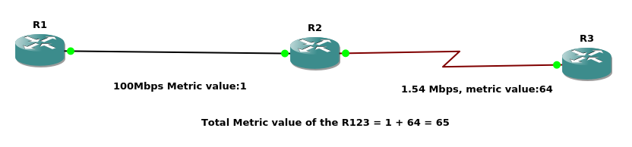
Calculate metrics to select shortest path
Shortest path will be selected based on the metric value of the path
Metric value = 100Mbps/bandwidth
Metric value of 100Mbps link will be 1
Metric value of 1Gbps link will be 1
Metric value of 10Mbps link will be 10
Metric value of 1.54Mbps serial link will be 64

Slide 14
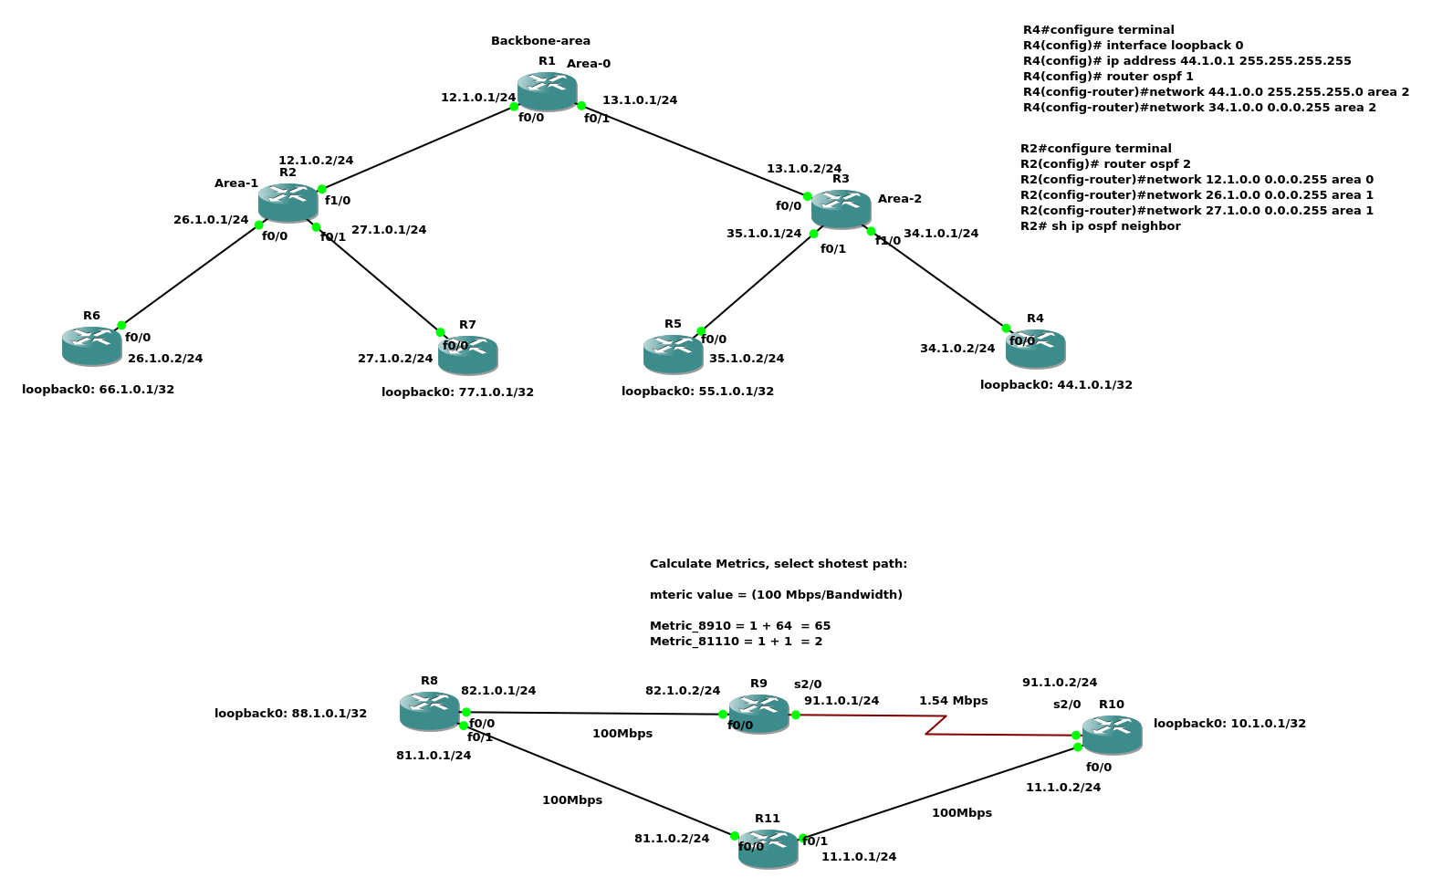
OSPF Demo

Slide 15
References:
CCNA certification guide
RFC_2328
Downloads:
Router images for GNS3
C3725
C7200
ospf_test_operations/

Slide 16
Thank you
Vishwanath Jadhav

